Slide 1
Network Application Architectures
CPSC 3600

Slide 2
Wireshark Lab
Any problems?

Slide 3
What are clients? Servers?

Slide 4
Network Application Architectures
Two main system architectures
Client-server model
Peer-to-peer model
Both live on the Edge
These are ways of organizing how applications talk to each other
All communication still routed through the same network layers we discussed last class

Slide 5
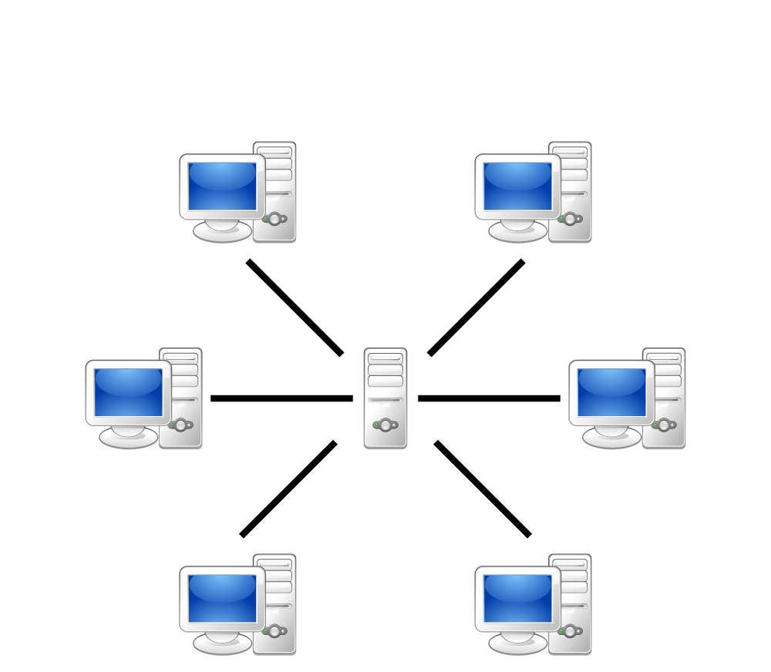
Client-Server Model
Clients request information from the server, server provides information to the clients
Clients don’t talk to each other
Very distinct roles (generally)
Clients don’t contribute to servers
Servers don’t initiate with clients

Slide 6

Servers
Must be always on or the application won’t work
Need a fixed IP address so clients can contact them
Bigger applications need better servers
Often need giant clusters of servers to handle all the clients
Also needs high throughput links to handle large amounts of traffic
But, can be run on anything if there aren’t many clients

Slide 7
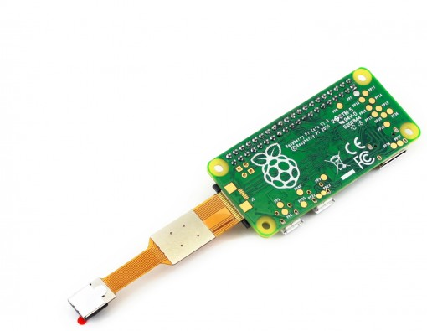
Clients
Only on when a user needs them
IP address doesn’t matter, because server doesn’t initiate contact with them
Rarely needs to be as powerful as a server

Slide 8
Client-Server Communication
Follows the request-response messaging pattern
Client submits request in agreed upon format
Server processes request and returns data in agreed upon format
The internals of both the client and server are hidden from each other (like network layers)
We will explore HTTP and DNS client/server models in two weeks

Slide 9
Let’s do a few Fermi estimates 1. What factors do we need assumptions about? 2. What are reasonable assumed values?
How many servers are needed to host the Web?
How much bandwidth does an average server need?

Slide 10
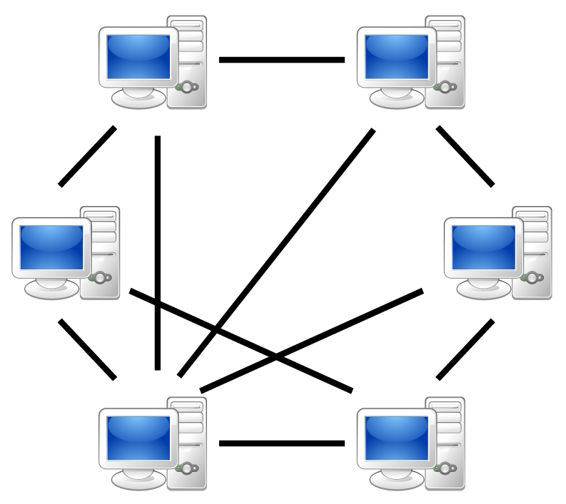
Peer-to-Peer (P2P) Model
No central server (or very little reliance on a central server)
Focuses on communication between peers (users/clients)
Examples include BitTorrent, Bitcoin, Skype

Slide 11
Peer-to-Peer (P2P) Model
Benefits
Self-scalable: as more users come online, computing power automatically increases
Cost-effective: no need for centralized servers, bandwidth
Potential problems
Security, privacy becomes more complicated
Often requires much more complicated models
Potential issues with performance and reliability
E.g. Skype collapsed twice due to problems

Slide 12
Scalability in P2P networks
Compare how long it would take to distribute a file to multiple users with a client-server model vs. a P2P model
Important factors
Size of file (F bits)
Number of users (N users)
Server’s upload speed (u_{s})
Ith Users’ download speeds (d_{i})
Ith Users’ upload speeds (u_{i})
How long will it take to distribute in a client-server model?

Slide 13
How long will it take to distribute a file under the following conditions using a client-server model?
File size = 500 MB
N = 10 users
U_{server} = 100 Mbps
U_{client[avg]} = 5 Mbps
U_{client[min]} = 1 Mbps
D_{client[avg]} = 20 Mbps
D_{client[min]} = 2 Mbps
T_{distribute} = max(NF/U_{server}, F/D_{client[min]})

Slide 14
How long will it take to distribute a file under the following conditions using a client-server model?
File size = 500 MB
N = 200 users
U_{server} = 100 Mbps
U_{client[avg]} = 5 Mbps
U_{client[min]} = 1 Mbps
D_{client[avg]} = 20 Mbps
D_{client[min]} = 2 Mbps
T_{distribute} = max(NF/U_{server}, F/D_{client[min]})

Slide 15
Scalability in P2P networks
Instead of client-server architecture, now consider where clients can also share with one another
Server starts with the file, peers share bits with others as they receive them
How long will it take to distribute in a P2P model?

Slide 16
How long will it take to distribute a file under the following conditions using a P2P model?
File size = 500 MB
N = 10 users
U_{server} = 100 Mbps
U_{client[avg]} = 5 Mbps
U_{client[min]} = 1 Mbps
D_{client[avg]} = 20 Mbps
D_{client[min]} = 2 Mbps
T_{distribute} = max(F/U_{server}, F/D_{client[min],}
NF/(U_{server} +sum(U_{client I}))

Slide 17
How long will it take to distribute a file under the following conditions using a client-server model?
File size = 500 MB
N = 200 users
U_{server} = 100 Mbps
U_{client[avg]} = 5 Mbps
U_{client[min]} = 1 Mbps
D_{client[avg]} = 20 Mbps
D_{client[min]} = 2 Mbps
T_{distribute} = max(F/U_{server}, F/D_{client[min],}
NF/(U_{server} +sum(U_{client I}))

Slide 18
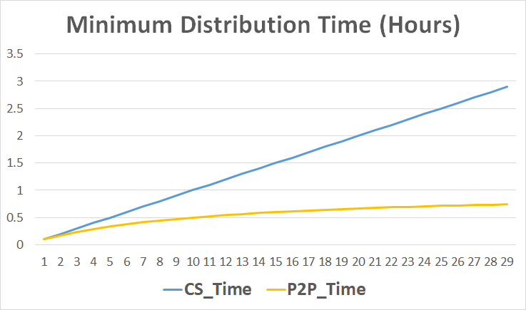
F = 900 MB u_{s} = 20 Mbps u_{i} = 2 Mbps d_{i} > u_{s}

Slide 19
Live Example
See excel spreadsheet

Slide 20
BitTorrent Protocol
(Mostly) decentralized process
Tracker servers help to coordinate process, but don’t host the files
Users download a .torrent file which contains information about the desired file, but not the files themselves
Using a BitTorrent client, users can begin downloading chunks of the file from peers who already have that file (or have parts of it)
Users begin uploading chunks as soon as they have received some data

Slide 21
.torrent format
Dictionary with the following values
Tracker URL
Info dictionary containing
List of files and their sizes
Number of bytes per piece (usually 256 KB)
Hash list used to verify the file once it is downloaded

Slide 22
Tracker node
The tracker is a server that helps to manage the download process for a given torrent
Its job is to keep track of all the peers currently seeding the torrent

Slide 23
BitTorrent Algorithm
New user joins the torrent, informs the tracker
Tracker sends the user a random list of other peers (assume 50 for this example)
User establishes TCP connections with other peers. This establishes the user’s neighboring peers.
This set evolves over time as peers drop out and as new peers join and are sent the User’s IP address by the tracker

Slide 24
BitTorrent Algorithm
User asks neighbors for lists of the chunks they have
Each neighbor will have different chunks, depending on what they have already downloaded
User then issues requests for chunks it doesn’t have yet
Asks for the rarest chunks first
This repeats as chunks are downloaded successfully

Slide 25
BitTorrent Algorithm
User also receives requests for chunks from neighbors, has to decide who to send chunks to
Wants to send chunks to the peers that are sending chunks back at the highest rates
Measure the rate at which you are receiving data from other peers and send chunks to the top 4. Recalculate every 10 seconds
Also, every 30 seconds start sending to a random peer. This allows the network to slowly settle into a state where peers are paired with other peers who have similar upload rates
Other peers do not receive any chunks

Slide 26
What is the purpose of a BitTorrent tracker?
To host the file being shared
To give new users their initial piece of the file
To inform users of who else has the file
To collect details about who has contributed to the file being shared

Slide 27
In BitTorrent, suppose Alice provides chunks to Bob throughout a 30-second interval. Must Bob return the favor and provide chunks to Alice in the same interval?
Yes
No

Slide 28
Before Next Class
Next class is the Python tutorial
Download and install VirtualBox before class
Download and install the VM using VirtualBox, will be sent by TAs
No homework for next class, enjoy the football game

